Slide 1
Seminar 9
BPMN Diagrams

Slide 2
Business Process Diagram
Each process can be represented by three different perspectives:
Private (non-executable) process - a private process that has been modeled to document the behavior of the process
Executable (internally) private process - a process that was modeled to automatically generate an executable version of the system based on the built model
Public process (abstract) - describes the interactions between a private process and another process or participant
Private processes = workflows = service orchestration = are internal to a particular organization

Slide 3
Private process example

Slide 4
Public process
Highlights only those activities that are used to communicate with another participant , only they will be included in the public process
Will provide the outside environment with information about the flow of messages exchanged, as well as their order

Slide 5
Collaboration diagram
The interaction between two or more organizational entities.
Typically contains two or more containers and message feeds that connect two containers or objects within the containers.
The message associated with a message flow can also be specified.
Can be represented in the form of two or more public processes communicating with each other
It is also acceptable that a container be empty, similar to a "black box“

Slide 6
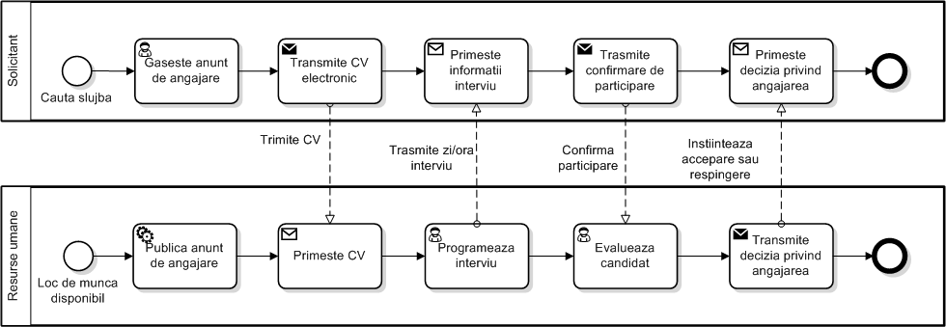
Collaboration diagram example

Slide 7
Create a process chart in BPMN for the process of deduction of expenses in an organization.
Process information:
After depositing the expense account, a new bank account is created if the employee does not already have one
The bill is then automatically sent for approval:
if the amount is below 1000 RON, the approval is automatic
if the amount is equal to or higher than 1000 RON, then the supervisor's approval is required
In case of rejection, the employee receives a notification by e-mail
If successfully approved, the amount is deposited into the employee's account
If no action occurs within 7 days, the employee receives an "Approval in progress“
If the application is not resolved within 30 days, then the process stops and the employee receives an e-mail informing him/her of it (cancellation) and he/she must resubmit.

Slide 8
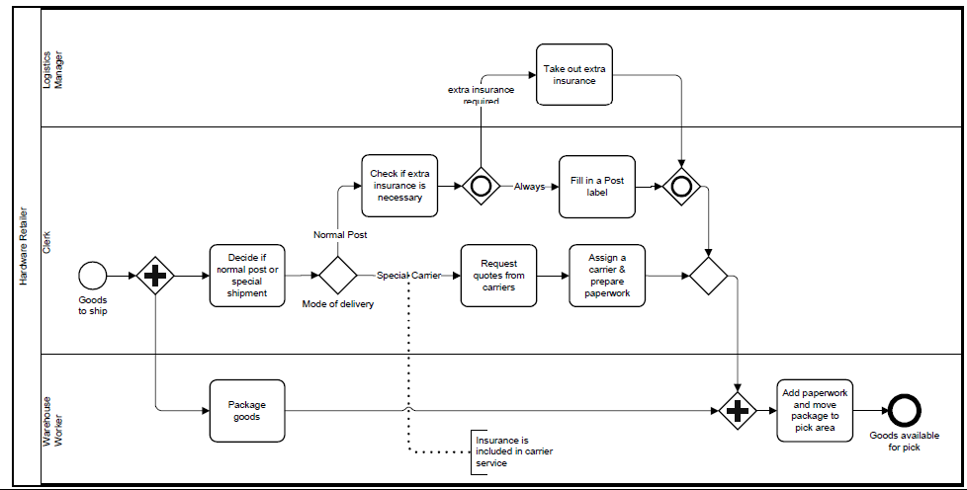
Interpret the following diagram

